Slide 1
Brain Machine Interface
By: Jasper Toothman

Slide 2
Overview

Slide 3
History

Slide 4
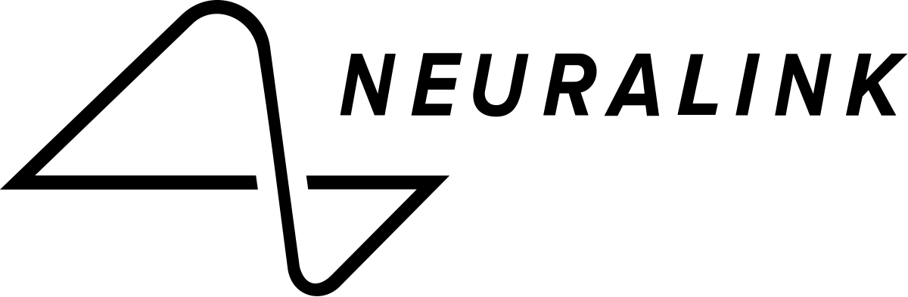
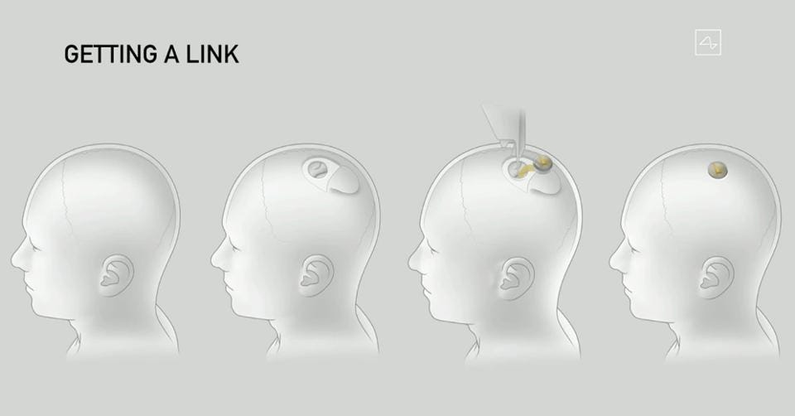
Implementation
One company who has not only begun but has made major headway is Neuralink. Neuralink is a company started by Elon Musk. They are focused using an implanted chip to allow you to interact with machinery remotely.

Slide 5

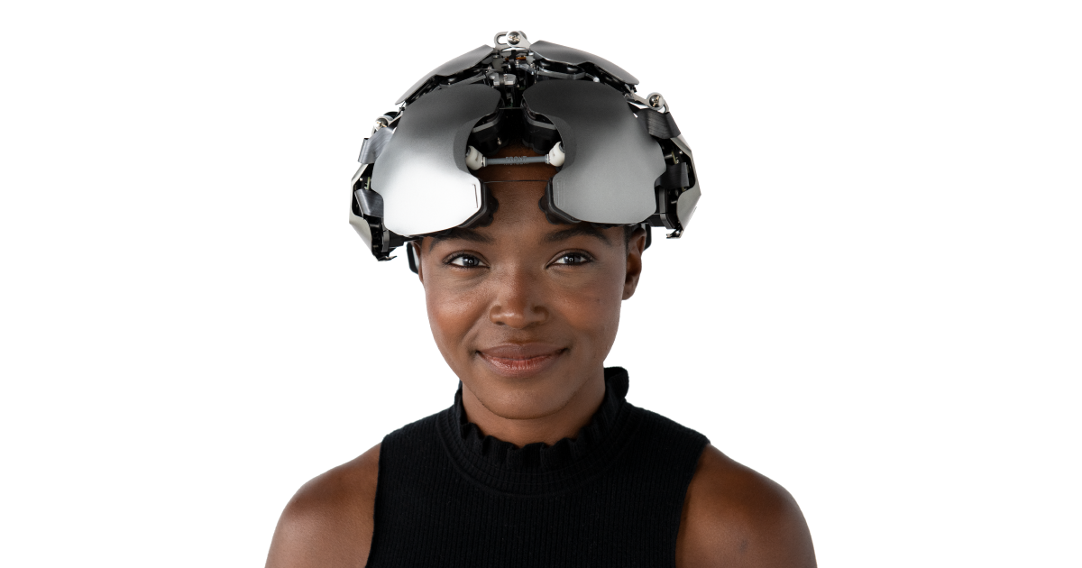
Implementation
Another company that is developing brain machine interfaces is Kernel. Kernel wants to create a way to store memories outside of the brain. They plan to do this through a neural chip as well.

Slide 6
Future Implementation
The future for Brain Machine Interfaces is limitless. They could be used to do simple task like opening a garage door or preheating an oven to doing complex calculation or making phonecalls using

Slide 10
References
Wiki Brain Machine Interface
Wiki Neuroprosthetics

